Slide 1





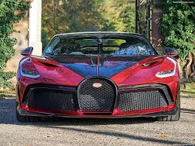




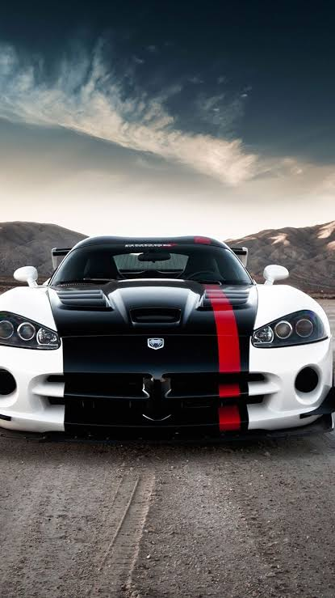







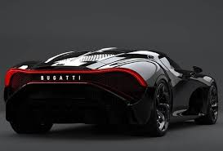


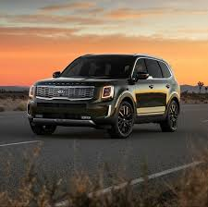
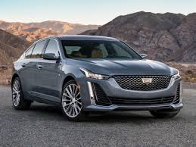

TWAMBI MOTORS
HOME GALLERY SHOP ABOUT US CONTACT US
MENU
ANOTHER SLOGAN
CATEGORY 1
CATEGORY 3
CATEGORY 5
CATEGORY 7
CATEGORY 9
ABOUT THE CATEGORY
ABOUT THE CATEGORY
ABOUT THE CATEGORY
ABOUT THE CATEGORY
ABOUT THE CATEGORY
CATEGORY 2
CATEGORY 4
CATEGORY 6
CATEGORY 8
CATEGORY 10
ABOUT THE CATEGORY
ABOUT THE CATEGORY
ABOUT THE CATEGORY
ABOUT THE CATEGORY
ABOUT THE CATEGORY

Slide 2


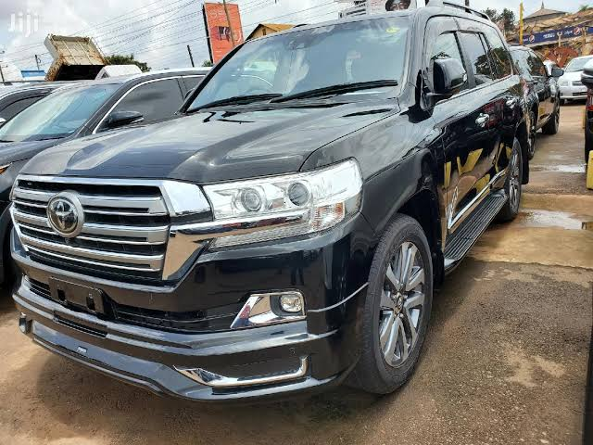
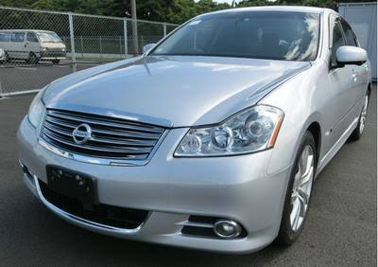
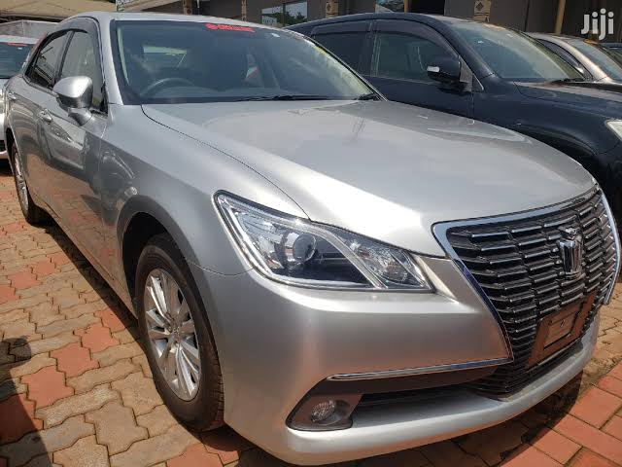
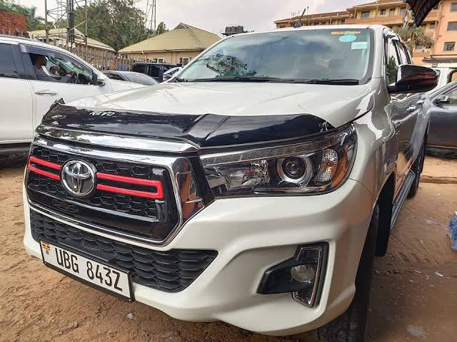
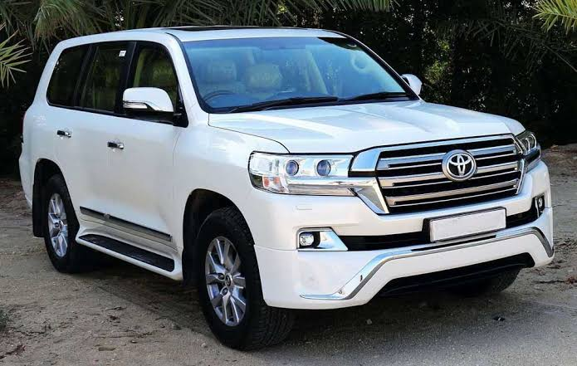
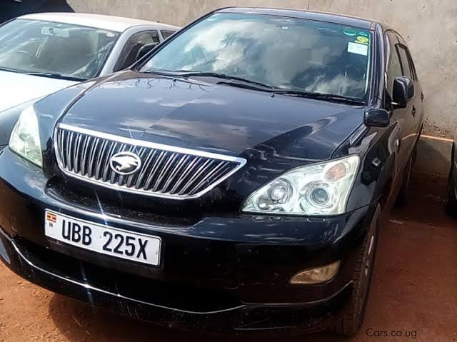
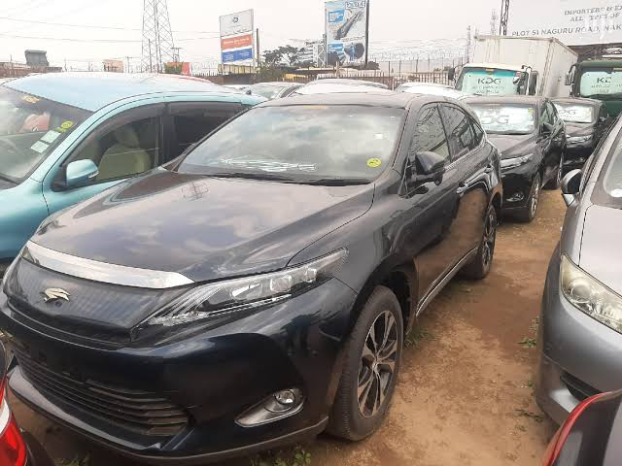
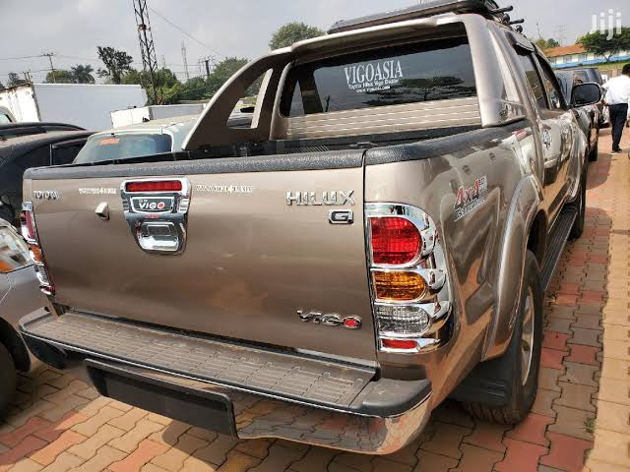
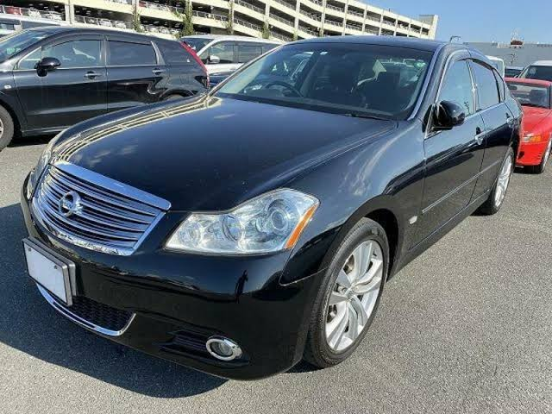
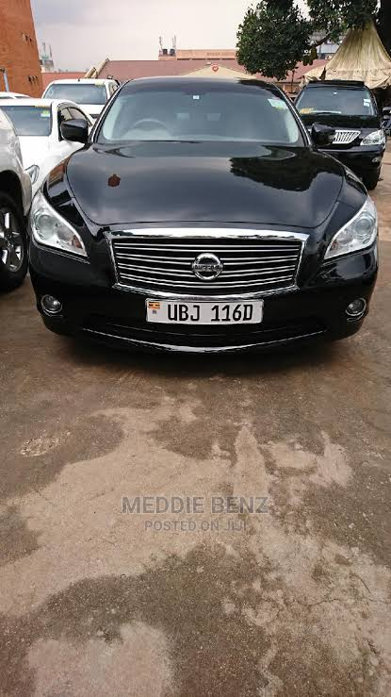
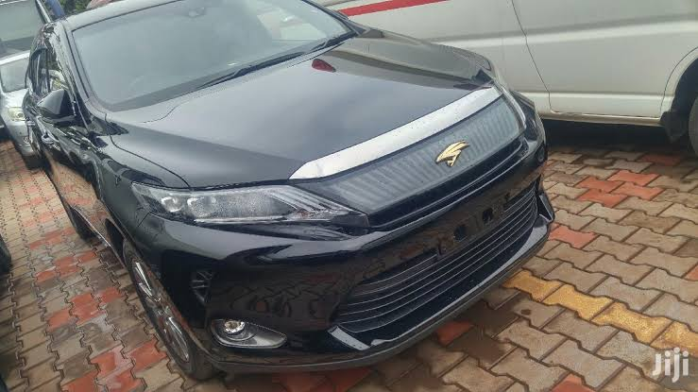

HOME GALLERY SHOP ABOUT US CONTACT US
NB: WE OFFER PROFETIONAL DRIVERS.

Slide 3


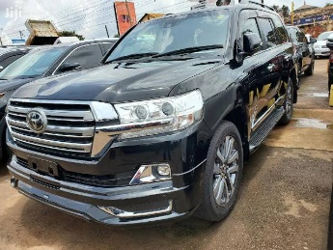
HOME GALLERY SHOP ABOUT US CONTACT US
Name and
about the product
and the price
Name and
about the product
and the price
Name and
about the product
and the price
Name and
about the product
and the price
Name and
about the product
and the price
Name and
about the product
and the price
Name and
about the product
and the price
Name and
about the product
and the price
Name and
about the product
and the price
Name and
about the product
and the price
Name and
about the product
and the price
Name and
about the product
and the price

Slide 4




HOME GALLERY SHOP ABOUT US CONTACT US
WHO WE ARE
A company that deals in new and used cars, we also have best personal professional drivers.
Address kampala, Uganda
we make our businesses with in Uganda
Our aim is to ease man’s work and also to empower our brothers in the same line of duty.
staff
BUSINESS HOURS
MON
7:00AM-6:00PM
SUN
About staff
About staff
About staff

Slide 5







HOME GALLERY SHOP ABOUT US CONTACT US
CONTACT US OR MESSAGE US
PHONE: +256 741 273 938 / +256 701 655 849
WHATSAPP: O741273938 / 0701655849
EMAIL: info@twambimotors.com
: www.twambimotors.com
: KAMPALA, UGANDA
ALWAYS OPEN TO SERVE YOU

Slide 6


Slide 7


